Slide 1
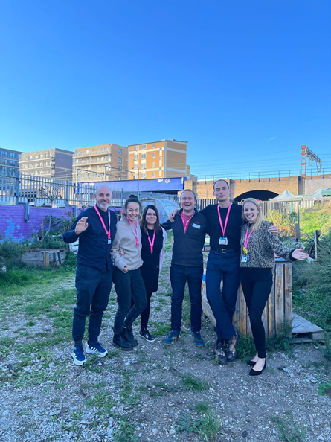
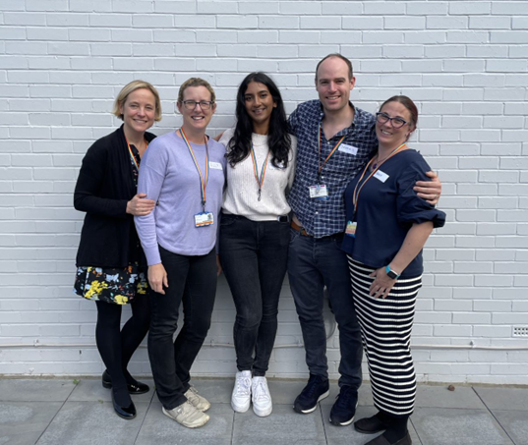
Lighting The Candle for Quality Improvement: The CANDLE Programme L.Fletcher¹ and A.Hunningher². ¹Anaesthetic Registrar, ²Anaesthetic Consultant, Department of Anaesthesia, Royal London Hospital
INTRODUCTION AND METHODS
What is CANDLE?
The Curriculum and Delivery Learning Event (CANDLE) is an innovative concept to deliver exceptional training and quality improvement (QI) action. QI methodology was used to plan the project
The programme comprises three key, complementary aspects:
Bespoke formal seminar-based training in QI background, methodology and tools delivered by expert trainers, to teams of trainee improvers. Aspects covered include building engagement, aims, change theory, driver diagrams and measurement
Expert coach-led, hands-on workshops, interspersed with the above seminars to apply newly learned skills immediately and directly to the set-up of trainee chosen projects, ensuring confidence in translation to the real world
Continued QI coach support and enhancement in the implementation and running of shop floor, peri-operative QI projects at hospital sites
The programme has been specifically tailored to meet the new 2021 Royal College of Anaesthetists QI Curriculum, which raises the bar on requirements for QI delivery and teaching and trainee needs
Why has CANDLE been developed?
Seventy anaesthetic trainees and trainers were surveyed on QI experience. Trainees consistently described low levels of formal QI knowledge, an inability to apply training to on-the-floor projects and frustration towards small-scale, low impact projects. They wished to see internal, bespoke training, higher quality projects and mentorship. QI was not part of many trainers own training. They described a lack of understanding, difficulty in applying methodology and low confidence in teaching QI
The CANDLE projects
RESULTS
Initial feedback
“The most useful thing was being given time to go through QI methodology with immediate practical application to projects we are passionate about.”
“The fact that improvement advisors, enthusiastic consultant supervisors and trainees were all mixed within the groups [was one of the most useful aspects of the course]. There was a wealth of experience and technical knowledge available.”
“This was better than any other similar course I’ve been on. It enabled us to conduct a large and meaningful project. It really helped with getting to grips with proper QI methodology.”
“[I learned] so much! Proper QI methodology. I learned from more than just my project, the different groups together sharing their learning was key to the success of the project.”
“An excellent experience that should be heralded to other centres.”
Figure 1. AIMS-HIGH
Figure 2. The Rainbows
Highlights of our projects to date
The Rainbows created a Team Brief proforma, now adopted across all adult theatres at our main tertiary centre. Aligned with NatSSIPs2, it's driving patient safety
The AIMS-HIGH team have implemented a package of care for high BMI maternity patients. Early preparation and checklists are driving higher standards of care. The project will be presented at the Obstetric Anaesthesia Annual Scientific Meeting 2023
New(er)ham Kids on the Block and Code Green recently won prizes (1st and 3rd respectively) in Sustainability Improvement at the Barts Health ‘WeImprove’ Awards. The CMO was impressed and is supporting the spread of their project interventions across hospital sites
CONCLUSION
By focusing on and raising standards across the entire QI process CANDLE has already impacted upon multiple peri-operative projects and will have a wide and lasting legacy on a range of future work. Ensuring confidence in the fundamentals of the QI process, teamwork and an actual ability to apply learning to real-life projects, is key to raising quality in improvement and training
Our project results to date demonstrate the success of the programme so far. We recognise the need to expand the programme, in future including the wider multi-disciplinary team and management. We believe that this will further increase the potential of the programme to significantly impact safe and effective peri-operative care
Acknowledgements: We would like to thank the Barts Health Trust Improvement Team, each of our individual project teams and the RCoA, who allowed us to contribute to their online QI newsletter https://rcoa.ac.uk/safety-standards-quality/quality-improvement/quality-improvement-case-studies/royal-london-hospital
c
Code Green | Operation Shutdown: reducing energy use in theatres at night
The Whitechapel Dreamers | Pre-operative fasting, Drinking, Eating and Mobilising after surgery (DrEaM)
The Dons | Improving the quality of the team debrief
The Rainbows | Improving quality of the team brief
AIMS-HIGH | Assessing and Improving Maternal Safety in High BMI patients
New(er)ham Kids on the block | Improving obstetric block testing utilising cold-stick testing
Team Whippets | Pre-operative fasting and patient education
Table 1. Project teams and title. Seven teams from across Barts Health were formed, comprising trainee members, a consultant supervisor and QI coach mentor

